Slide 1

AI Coder: Vibe Coder to Agentic Engineer
The Missing Manual
Week 3
Day 4

Slide 2
3 Weeks to Expert Agentic Coder
Core skills
Products / Features
Projects
Week 3: Agentic Engineering as an expert
Multi-Agents
Sub-Agents
Hooks
Sandboxing
Large Codebase
Workflow
Swarms
Orchestrators
Project 4: Capstone
Week 2: Vibe Engineering as a professional
Claude Code
OpenCode
others
Commands
Checkpoints
Ralph Loops
MCP
Skills
Plugins
Workflows
Team
Debugging
Project 3: SaaS Platform
Week 1: Vibe Coding for fun and profit
Agentic Coding Landscape
Foundations
AGENTS.md
Context
Cursor
Copilot, Codex
Antigravity
Project 1: YOLO
Project 2: Commercial MVP

Slide 3
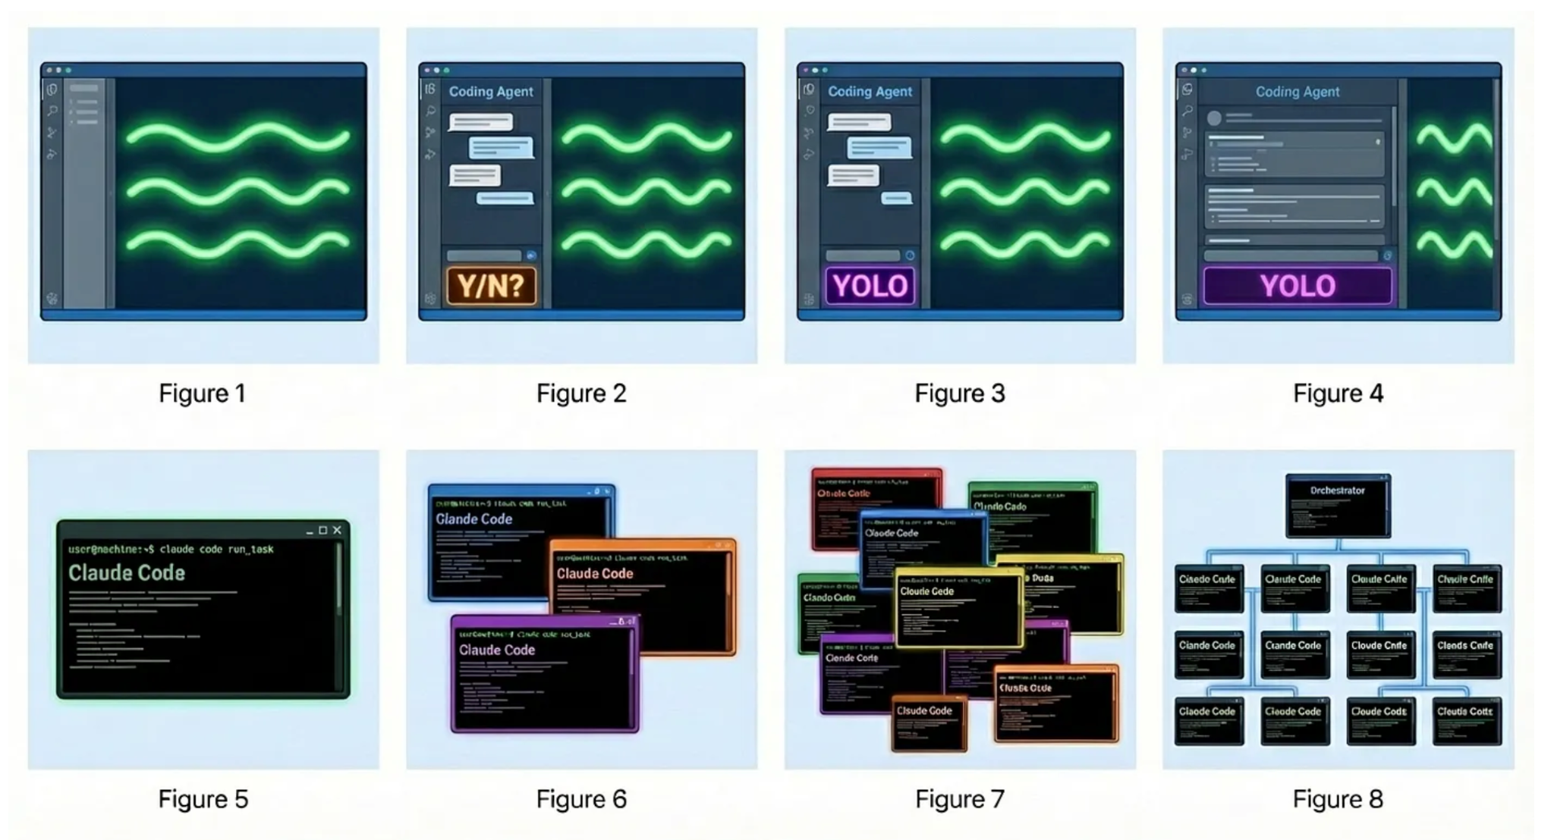
“Evolution of the Programmer in 2024–2026” by Steve Yegge
Stage 1
Stage 2
Stage 3
Stage 4
ChatGPT
AI auto-complete
Coding agent in IDE sidebar, asks permission before changes
Coding agent in IDE sidebar, YOLO mode
Coding agent in IDE main window, YOLO mode, check diffs
Stage 5
Stage 6
Stage 7
Stage 8
Coding agent in CLI, YOLO, diffs scroll by
Multi-agent in CLI, 3-5 agents
10+ agents in CLI manually managed
Agents orchestrate agents

Slide 4
Claude Agent Teams
What they are
Coordinate multiple Claude Code instances
One acts as the Team Lead, assigning tasks
Team-mates work and interact independently
When to use them
Parallel research; debug with different hypotheses
Own independent modules
Own different layers (frontend, backend, etc)

Slide 5
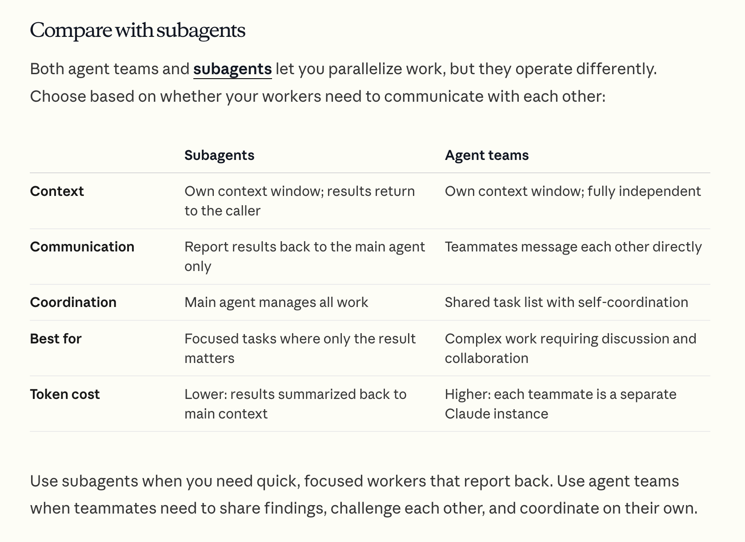
Claude Agent Teams
https://code.claude.com/docs/en/agent-teams

Slide 6
Instructions
1. Add to settings.json
{
"env": {
"CLAUDE_CODE_EXPERIMENTAL_AGENT_TEAMS": "1"
}
"teammateMode": "in-process"
}
2. Prompt Claude: “Create an agent team to…”
3. Shift+Tab to delegate mode; also: “Wait for your teammates to complete their tasks before proceeding”
4. Shift up+down to select team-mate
5. Commands to stop when complete: “Ask the researcher teammate to shut down”
“Clean up the team”
Invest in CLAUDE.md; expect cost; be willing to start over

Slide 7
3 Weeks to Expert Agentic Coder
Core skills
Products / Features
Projects
Week 3: Agentic Engineering as an expert
Multi-Agents
Sub-Agents
Hooks
Sandboxing
Large Codebase
Workflow
Swarms
Orchestrators
Project 4: Capstone
Week 2: Vibe Engineering as a professional
Claude Code
OpenCode
others
Commands
Checkpoints
Ralph Loops
MCP
Skills
Plugins
Workflows
Team
Debugging
Project 3: SaaS Platform
Week 1: Vibe Coding for fun and profit
Agentic Coding Landscape
Foundations
AGENTS.md
Context
Cursor
Copilot, Codex
Antigravity
Project 1: YOLO
Project 2: Commercial MVP

Slide 8

AI Coder: Vibe Coder to Agentic Engineer
The Missing Manual
93%
Complete

